Slide 1
Reinforcement Learning in Games
Ege Can Özer
Notes:
Many of you’ve probably heard the recent success of a system called AlphaGo beating the world Go champion Lee Sedol in the game of Go. This was totally unexpected. In fact, it is thought that AI was far away from achieving this result.
However, I am not going to talk about AlphaGo, instead, I am going to talk about how we come up to this point.

Slide 2
Outline
[LYY12]
Reinforcement Learning to Play Mario
High-level Reinforcement Learning in Strategy Games
Temporal Difference Learning and TD-Gammon
Playing Atari with Reinforcement Learning
[AmS10]
[Tes95]
[MKS13]
Notes:
For this reason, I will present 2 crucial articles that are both referenced by the AlphaGo paper
On top of that, to make the the main topic more complementary, I will first demonstrate 2 introductory articles about RL in games.
But just before that lets clarify, what is the main motivation to study reinforcement learning algorithms in games

Slide 3

Motivation
Less complicated and controlled environment
Clear-cut rules, when to reward/punish/end
Concrete evaluation measurements
Win %, kill rate, score, time spent
Easy to realize
At least no need to wait for a fund to buy a robot arm ☺
Provides a common tool
Training and testing (Benchmark)
Notes:
Compared to real-life examples, games provide ..
The tool can be used not only for training the agent but also testing and providing objective benchmarking among different systems.

Slide 4

Challenges
Implementation POV
Hard to find SDK, let’s create the game from scratch
Abstracting the environment
Performance measures: No hand labeled ground-truth set
Benchmarking tools, Human players, Evaluate individual decisions
Further challenges
Exploitation vs exploration
More problems Deep Learning perspective
Notes:
Sounds up to perfect now, however, it has also challenges
Maybe 25 years ago this was actually challenge and ending up creating game from scratch, but now there are more open sourced contents. But still if we want to develop AI on something specific it can be hard to find such SDK due to trademark.
So lets begin with first paper

Slide 5
Reinforcement Learning to Play Mario [LYY12]
Aim of this study
Design an agent to play and beat the game Mario
Q-learning is model-free
Algorithm oblivious to transitional probabilities
Performs well under specific constraints
Mario AI Framework
Used to both train and test the system
Fast convergence and decent results
5000 iterations, 90% win probability
Notes:
First article is about some typical RL application by Liao et al. That aims to design ...
Search space is actually huge (we’ll see next) it is hard to compute probs.
Such as memory,space and time constraints, 24 fps. And simply this actually fit their needs
The framework provides many details about the action going on. So it is fairly easy to do low-level abstraction
So even the elementary RL algorithms able to get good results

Slide 6
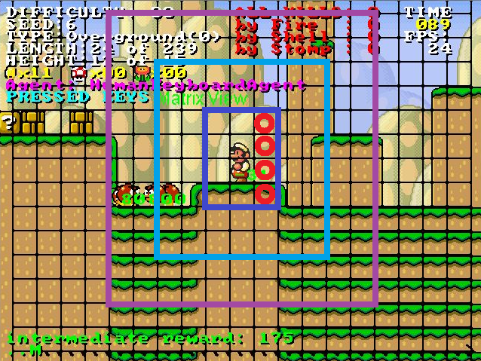

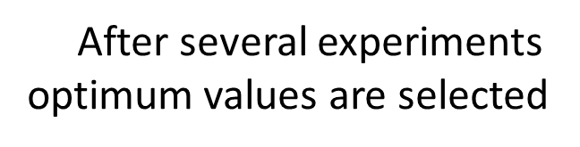
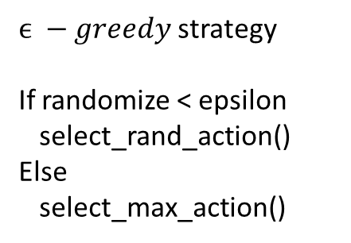

Mario mode: 0 – small, 1 – big, 2-fire
If on ground: 0 or 1
If can jump: 0 or 1
If stuck: 0 or 1
Nearby, midrange, far enemies
If enemies killed by stomp: 0 or 1
...
A state needs 39 bits to encode
Learning rate
$$a\left(s_{t}, a_{t}\right)=\frac{a_{0}}{\# of times a_{t} performed in s_{t}}$$
Q-table
States
How fast learning converges
Positive reward
Moving forward, jump on higher platforms
Reward decreases when there is an enemy nearby
Killing enemies
Negative reward
Colliding with enemies
Being stuck
Initialized with a uniform distribution
Discount factor
Mario performs one of 12 actions
{LEFT, RIGHT, STAY} X
{JUMP, NOT_JUMP} X
{SPEED/FIRE, NOSPEED} X
How much future state is taken into account
Actions
Reward function
$ϵ −greedy$ strategy
If randomize < epsilon
select_rand_action()
Else
select_max_action()
Using Mario AI framework those variables defined
States
Actions
Reward function
Decreasing learning rate
Discount factor
Notes:
Lets take a look at briefly how does the algorithm work

Slide 7
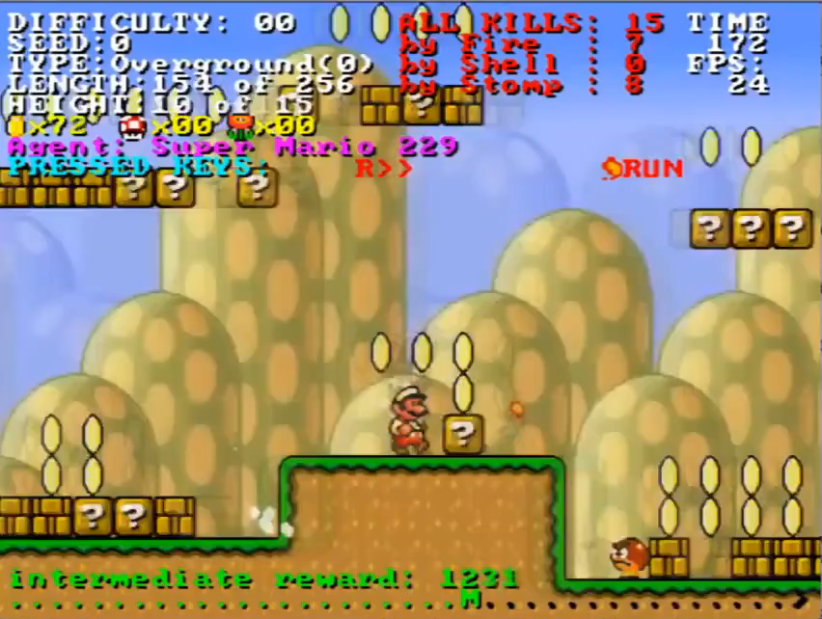
Reinforcement Learning to Play Mario [LYY12]
Four measures
Composite score
Win status
Kills in total
Distance passed
Time spent in frames
Four measures
Composite score
Winning probability
% of Monster killed
Time spent
Notes:
This cross meaning they tested the trained agent in a different level, since it did not trained on that level it performed bad
One critics about the paper, even though they use Mario AI framework, common tool to evaluate, they did not provide any benchmarking.

Slide 8
High-level Reinforcement Learning in Strategy Games [AmS10]
Civilization IV, turn-based strategy game
Many paths to victory
Goal is to improve built-in AI
Switching between high-level strategies using RL
Change leader traits according to situtation
Leave the low-level actions to build-in AI
Create unit, upgrades etc.
They compared 3 algorithms:
Q-learning vs Dyna-Q vs Dyna-Q with factored state representation
Focus only on high-level RL learning and abstraction of the game environment!
Notes:
Amato and Shani introduce an approach to improve the built-in AI by applying RL algorithm
military domination, cultural, diplomatic, technological, time victories.
If you are playing with Gandhi you can change either Spiritual – philosophical
Dyna-Q model-based Q learning, meaning learn directly the policy without for example reward and transitions
Factored state representation, which is basically same Dyna-q with an assumption of conditionally indepence between state transitions, thus reducing the search space

Slide 9
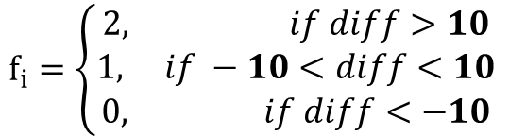
State space
Action space
Reward model
4 state features, in total 81 possible states
Population difference
Land diff.
Military power diff.
Remaining land
Reward based on the score provided by game
Immediate reward, given after each step as
Still possible to lose the game while having high score
What is the Action?
Choice of a new strategy (high-level)
For making low-level decisions
Build, explore, make war etc.
Limited to 4 leaders
Covers all 8 possible leader traits
For example
Washington has Financial and Organized traits
All common and provided by game
thisStepScore = myTotalScore – yourTotalScore
$f_{i}=\left\{\begin{aligned}2, if diff>10 \\ 1, if −10<diff<10 \\ 0, if diff<−10\end{aligned}\right.$
Notes:
They discretized onto numerical values, The difference is for example, player’s military power – opponent’s military power. Numbes are different for different resource types.
Reward: but the game score is obviously higly correlated with the final outcome of the game

Slide 10
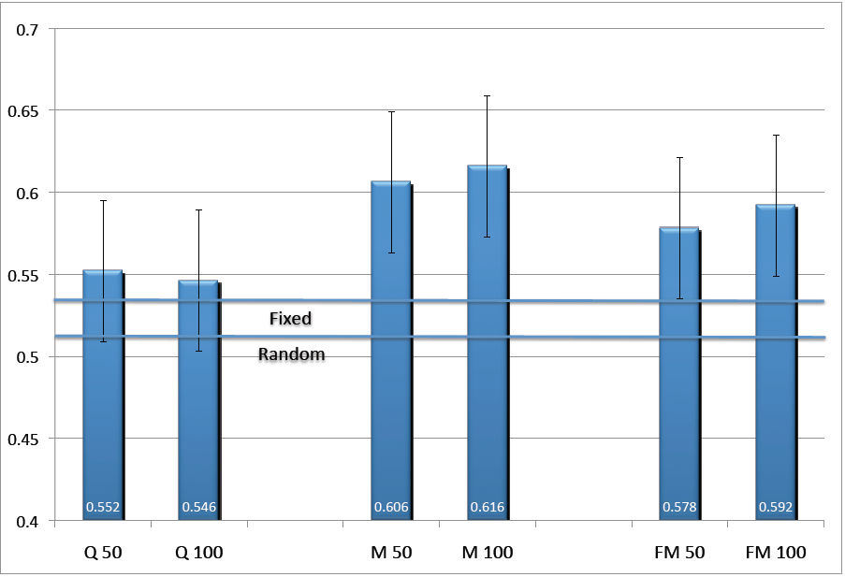
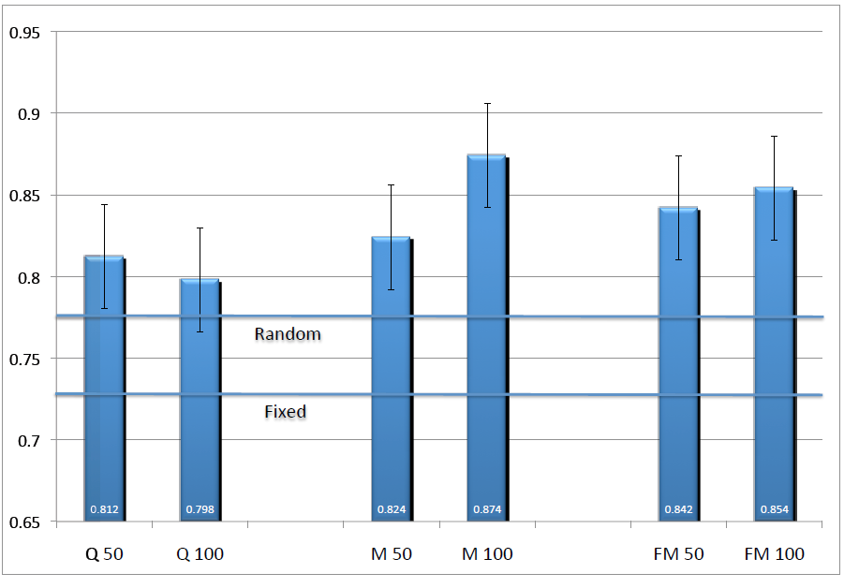
High-level Reinforcement Learning in Strategy Games [AmS10]
versus
versus
Gandhi
Fredrick
Washington
Genghis Khan
Organized
Philosophical
Expansive
Charismatic
Spiritual
Philosophical
Aggressive
Imperialistic
Notes:
They compared 3 different algoritms, left, middle, right with also different learning # of episodes, 50-100
Fredrick vs Washington matchup, least is Q-learning by 0.54, most is by Dyna-Q 0.62
I did not include fixed versus random policy strategy selection in here but those lines mean:
Fixed line meaning, percentage of games each leader would win against the chosen opponent
In this case, Fredrick wins against Washington approximately .53 percent
Random policy means, choosing random leader traits at each step
50-100 Learning episodes
Gandhi has an advantage over Genghis Khan.
Critics again on evaluation, they could give mirror match-ups to see actual decision making process.

Slide 11
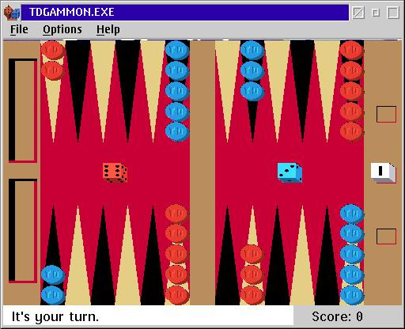
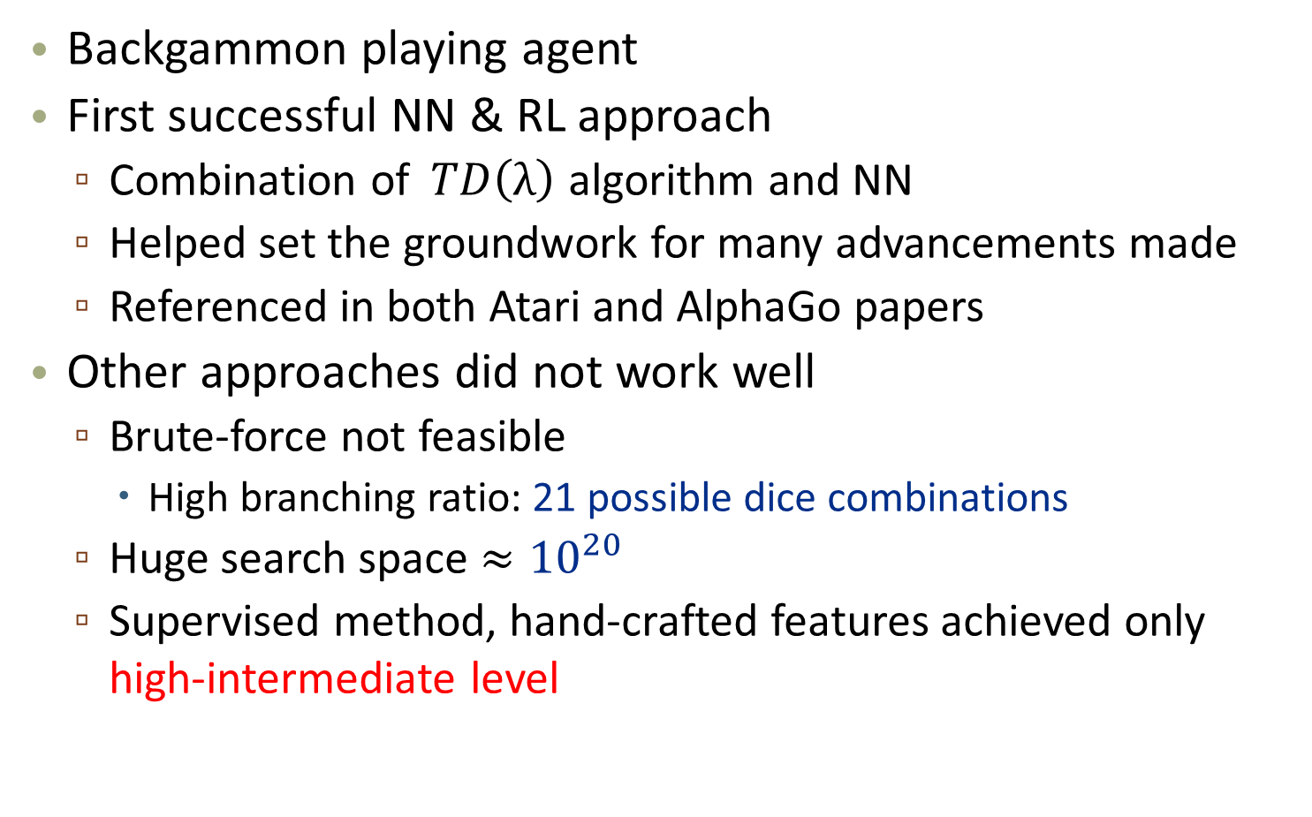
Temporal Difference Learning and TD-Gammon [Tes95]
Backgammon playing agent
First successful NN & RL approach
Combination of$TD\left(λ\right)$ algorithm and NN
Helped set the groundwork for many advancements made
Referenced in both Atari and AlphaGo papers
Other approaches did not work well
Brute-force not feasible
High branching ratio: 21 possible dice combinations
Huge search space $≈{10}^{20}$
Supervised method, hand-crafted features achieved only high-intermediate level
Notes:
Gerald Tesauro published his paper in 1992 describing TD-Gammon as a neural network trained with reinforcement learning. It is referenced in both Atari and AlphaGo research papers and helped set the groundwork for many of the advancements made in the last few years.

Slide 12
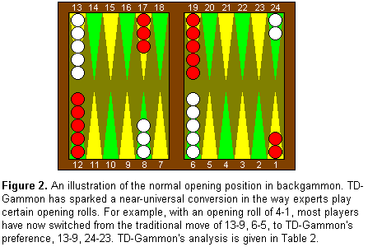
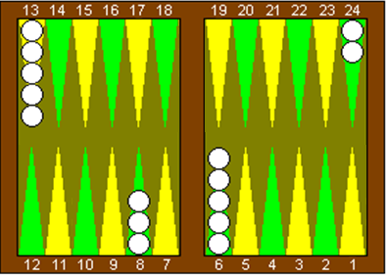
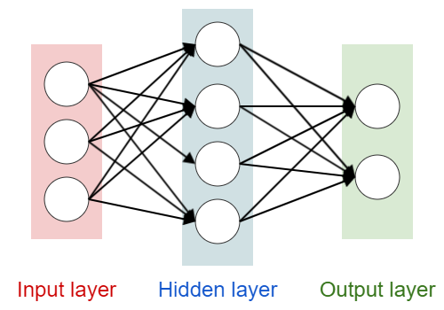
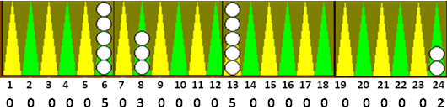
Remove one side
Get # of checkers as feature vectors
White | Normal
Red | Gammon
Notes:
Give the feature vectors as the input to the NN model
In the output layer, 4 nodes corresponding to the result with White Normal, White Gammon

Slide 13
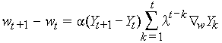
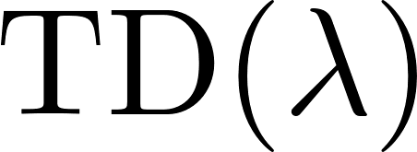
Pr(White wins)
Pr(White gammons)
Pr(Red wins)
Pr(Red gammons)
After each turn, each weight in NN gets updated according to :
First chooses any legal move
After NN weights updated (backpropagation), picks the maximum weighted corresponding move.
Self-training scheme and stochastic environment of the game improves the NN. Why did TD-Gammon work? [PoB97]
to change the weight from its
value on the previous turn
The difference between current and
previous turn’s board evaluations
Learning rate
Controls the decay of older estimates.
If => 0
Corrects only the previous turn’s estimate
If => 1
Attempts to correct all previous turns
The gradient of NN output w.r.t to weights
Notes:
is the amount to change, is the difference between, parameter, how much current evaluation should affect previous estimates,
Pollack and Blair

Slide 14
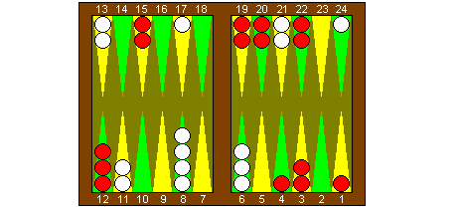
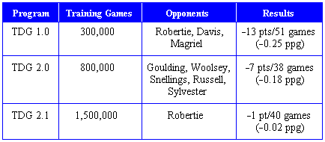
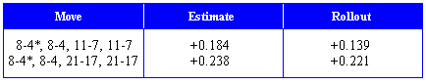
Temporal Difference Learning and TD-Gammon [Tes95]
White is to play 4 - 4
Addition!
Later in TDG 3.0 using 160 hidden nodes and a selective 3-ply search,
managed to beat Kazaros +6pts /20 games
Notes:
1.0 : Hidden nodes: 40, 1-ply move selection
2.0 : 40 hn., 2-ply move selection (lookahead)
2.1 : 80 hidden nodes, 2-ply move selection
The system also contribute to change the way game played

Slide 15
Playing Atari with Reinforcement Learning [MKS13]
Context-free
Input only from sensory data
Deep Q-network (DQN) = Q-learning + CNN
Main goal
Successfully learn to play as much games as possible.
7 Atari games, implemented in the Arcade Learning Environment
Using RL and DL together seems problematic
Highly correlated states vs data samples are independent
Distribution changes vs fixed underliying distribution
Experience replay mechanism
Randomly sample previous transition = smooth the distribution
Notes:
Up to know we saw that game specific information encoded to the algorithm by means of states, action, reward. Mnih et al. Proposes a context-free approach which model takes the information nothing but from images/video input
The main goal is to CREATE AN AGENT THAT IS ABLE TO SUCCESSFULLY ....
In RL data samples are usually consists of highly correlated states, whereas from the DL perspective it is assumed that data samples are independent
The article proposes a experience replay mechanism to alleviate aforementioned problems of correlated data and non-stationary distributions, that is, distribution does not change when shifted over time
At each step of training, E.R.M. Randomly sampels previous transitions and thus smooth outs the distribution.

Slide 16
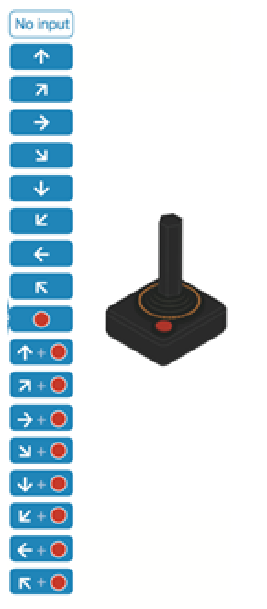
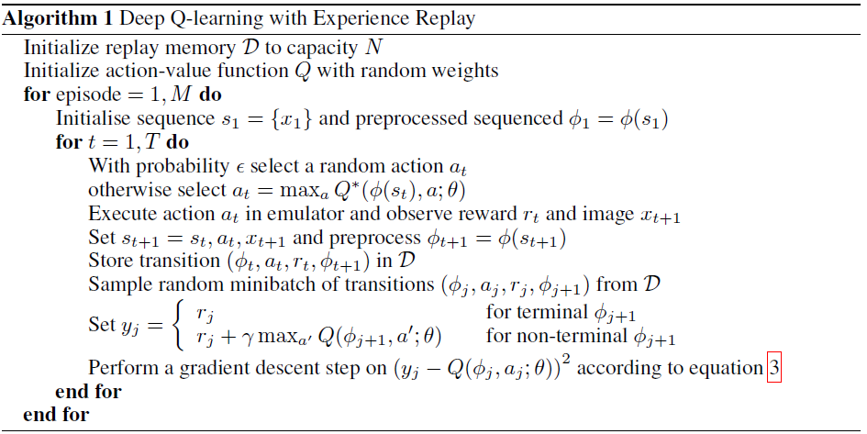
preprocessed
For each replay memory «j»
Game screen
Game
action = move_left
Deep Q Network
For playing
Replay memory
Consequent reward
Consequent state
State
Action
Current state
Replay memory
Smooth training distribution
Preprocessor
Compute Reward
Pick an action
Game
Game screen
Preprocessor
If terminal memory -> current reward
Otherwise; update w.r.t. Max Q value of A
Replay memory
Consequent reward
Consequent state
State
Action
Compute loss
and Update network
Gradient descent
Add to
Action with highest Q-value
Random action
Replay memories
Action
Game
Notes:
Preprocessor: Converted RGB to gray scale and scaled down to 84x84, with 4 consecutive frames to get better motion from te game state.

Slide 17
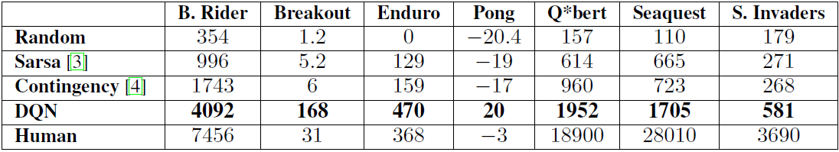
Playing Atari with Reinforcement Learning [MKS13]
Average total reward
Notes:
DQN beats the all various approaches in all 7 seven games.
However, it is only be able beat the human players in 3 games.

Slide 18
Conclusion
Summary
Some problems in articles
Evaluation
Context specific outcomes.
What to expect next?
Deep Reinforcement learning everywhere
Faster, less hardware requirements
Sandbox learning, already tried in NN
Trained outside of context
Could this be approach used in CNN
In order to
Notes:
How presentation will benefit audience: Adult learners are more interested in a subject if they know how or why it is important to them.
Presenter’s level of expertise in the subject: Briefly state your credentials in this area, or explain why participants should listen to you.

Slide 19
Thank you for listening!
Questions?
Notes:
How presentation will benefit audience: Adult learners are more interested in a subject if they know how or why it is important to them.
Presenter’s level of expertise in the subject: Briefly state your credentials in this area, or explain why participants should listen to you.

Slide 20
References
[AmS10] Amato, C. and Shani, G., High-level reinforcement learning in strategy games. Proceedings of the 9th International Conference on Autonomous Agents and Multiagent Systems: volume 1-Volume 1. International Foundation for Autonomous Agents and Multiagent Systems, 2010, pages 75-82.
[LYY12] Liao, Y., Yi, K. and Yang, Z., Cs229 nal report reinforcement learning to play mario. Technical Report, Technical report, Stanford University, 2012.
[Tes95] Tesauro, G., Temporal dierence learning and td-gammon. Communications of the ACM, 38,3(1995), pages 58-68.
[MKS13] Mnih, V., Kavukcuoglu, K., Silver, D., Graves, A., Antonoglou, I., Wierstra, D. and Riedmiller, M., Playing atari with deep reinforcement learning. arXiv preprint arXiv:1312.5602
Notes:
How presentation will benefit audience: Adult learners are more interested in a subject if they know how or why it is important to them.
Presenter’s level of expertise in the subject: Briefly state your credentials in this area, or explain why participants should listen to you.

